Slide 1

AGRI ai
Batch : 07
Ch Karthik - 187y1a1218
Balla bala ganesh – 187y1a1208
Guided by : g sunil Santosh kumar

Slide 2
Hackathon details
https://innovateindia.mygov.in/ai-for-agriculture-hackathon/
https://www.iasbhai.com/agri-india-hackathon-2021-upsc/

Slide 3
Abstract
AgriAI is a machine learning based we application build using React and Flask.
AgriAI is used for recommending Crop and Fertilizers based on the soil features. The application used three accuractely predciting models to make the final predictions. The link for the python notebooks containing the implementation for the models are present in the All Links section of this Readme.
An API was built using Flask and was deployed on Heroku. This Flask API is used to get the recommendation made by the machine learning models in JSON format. The input data is sent as a POST request to the API to get the predicted information.React JS was used to build the frontend part of the application. JS packages such as MaterialUI, Axios, react-router-dom were used for frontend part of the web application

Slide 4
introduction
AI systems are helping to improve the overall harvest quality and accuracy – known as precision agriculture. AI technology helps in crop prediction ,fertilizer usage and poor nutrition of farms. AI sensors can detect and target weeds and then decide which herbicide to apply within the region.
We use state-of-the-art react,flask,machine learning and deep learning technologies to help you guide through the entire farming process. Make informed decisions to understand the demographics of your area, understand the factors that affect your crop and keep them healthy for a super awesome successful yield.

Slide 5
Problem statement
Crop Guidance and Fertilizer Recommender :
Helping the Farmer in terms of Crop Guidance and Fertilizer Recommender .

Slide 6
Software requirements
Flask
Fire base
Python

Slide 7
Hardware requirements
Operating system: Windows, Linux
Processor : minimum Intel i3
Ram: minimum 4gb
Hard disk : minimum 250gb

Slide 8
Proposed system
The aim of proposed system is to help farmers to cultivatecrop for better yield. The crops selected in this work arebased on important crops from selected location. Theselected crops are Rice, Jowar, Wheat, Soyabean, andSunflower, Cotton, Sugarcane, Tobacco, Onion, Dry Chilietc.
Crop Yield Prediction:Crop Yield Prediction can be done using cropyield data, nutrients and location data. Theseinputs are passed to Random Forest and SupportVector Machine algorithms. These algorithms willpredict crop based on present inputs.
Fertilizer Recommendation:Fertilizer Recommendation can be done usingfertilizer data, crop and location data. In this partsuitable crops and required fertilizer for each cropis recommended

Slide 9
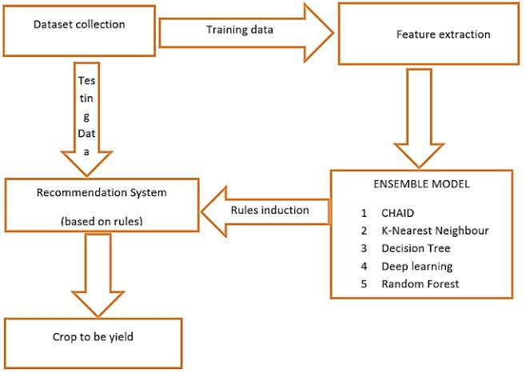
Flowchart

Slide 10
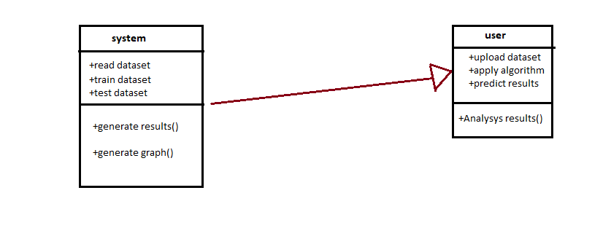
Class diagram

Slide 11
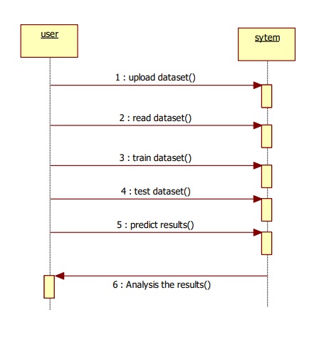
Sequence diagram

Slide 12
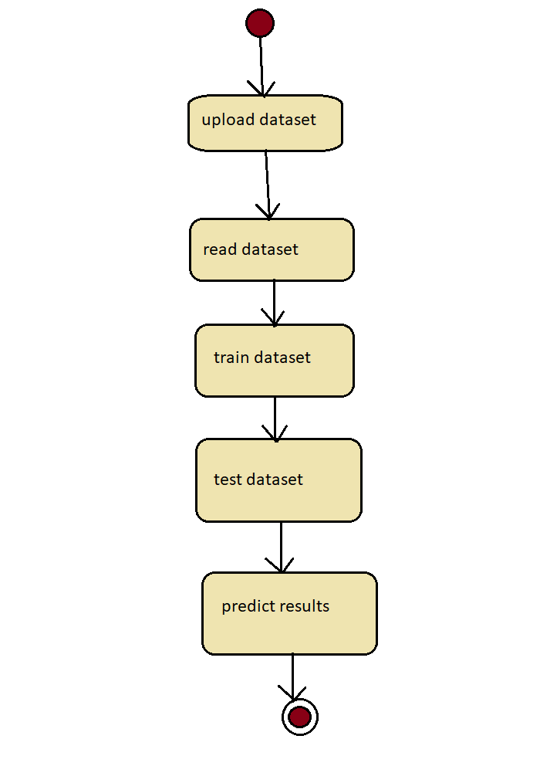
Activity diagram

Slide 13
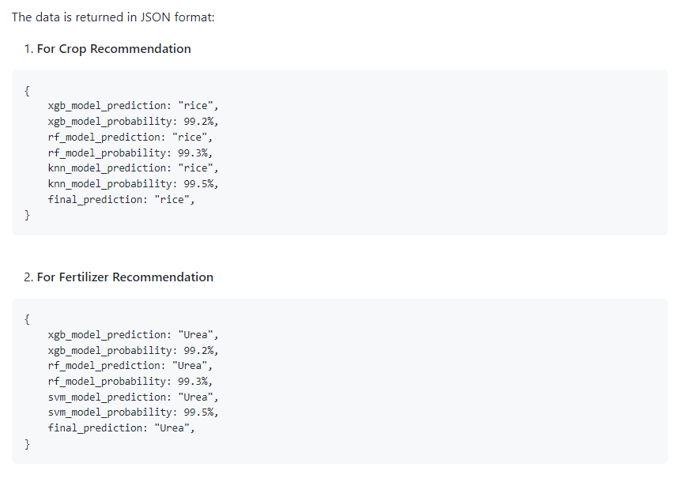

Slide 14
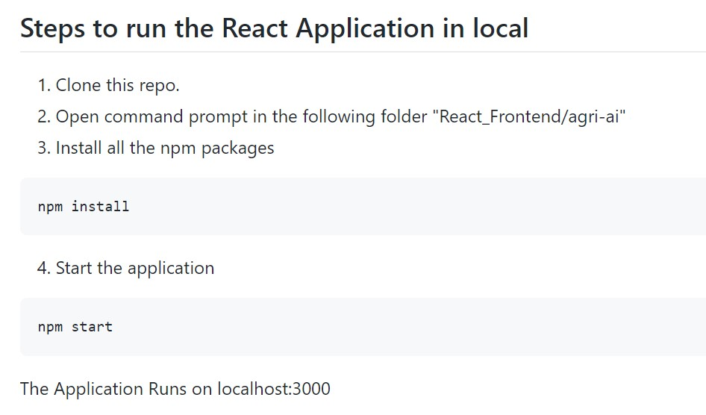

Slide 15
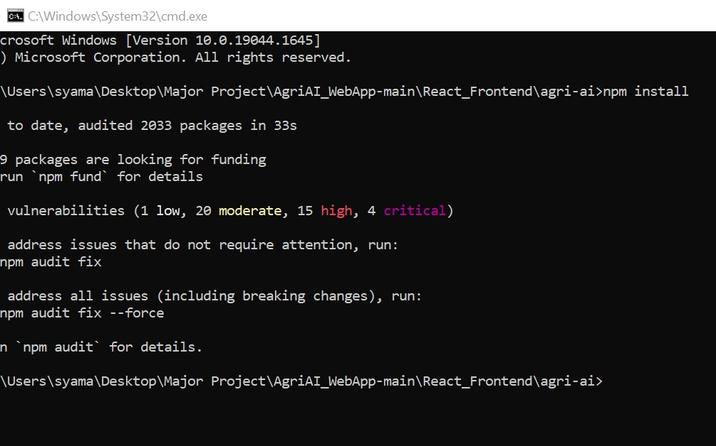
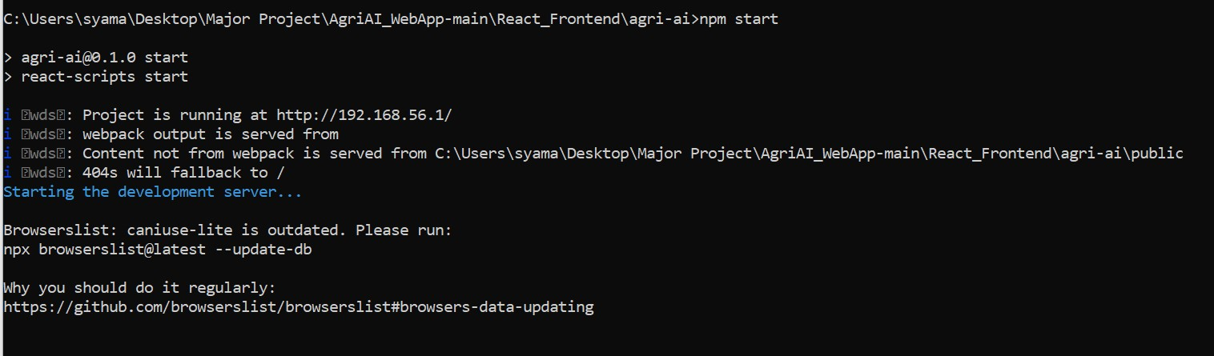
NPM Install
NPM Start : To connect local host.

Slide 16
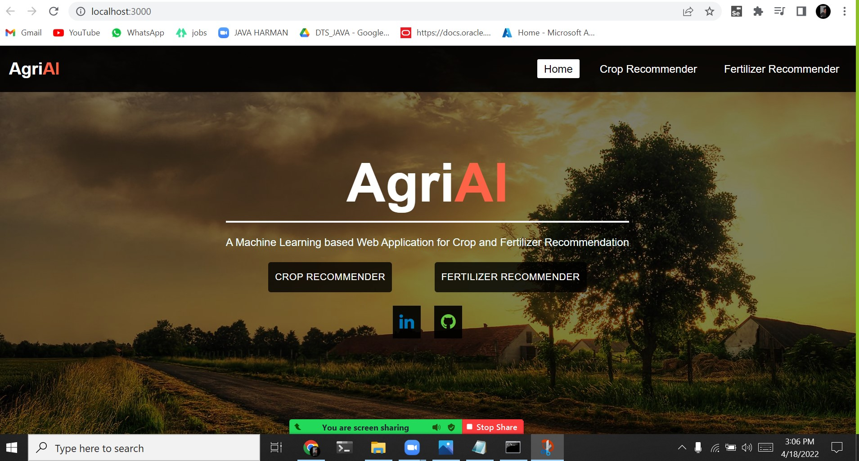
Final Output : Tab 1

Slide 17
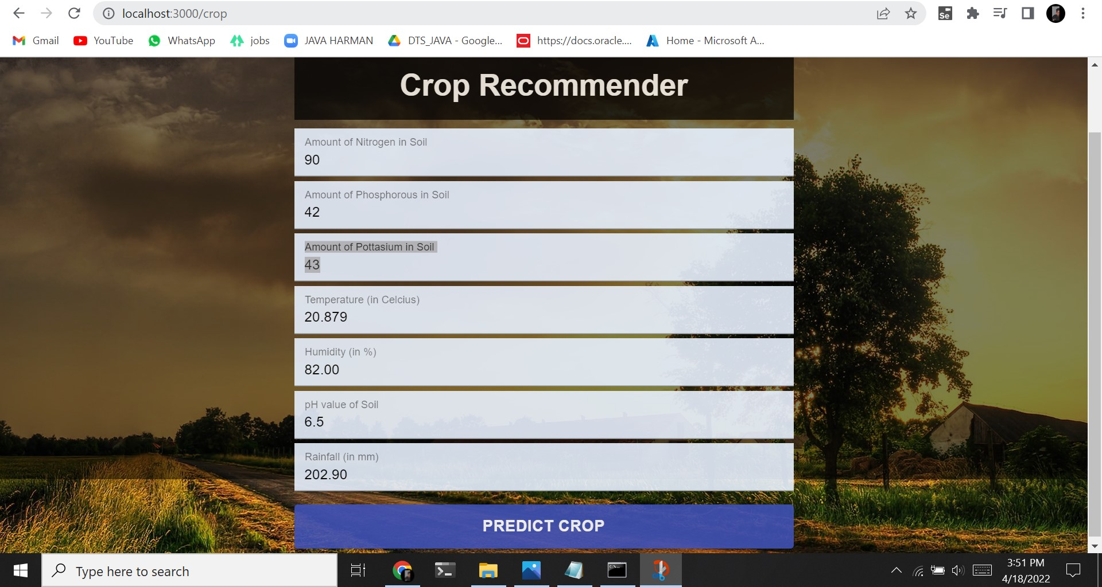
Crop Recommender

Slide 18
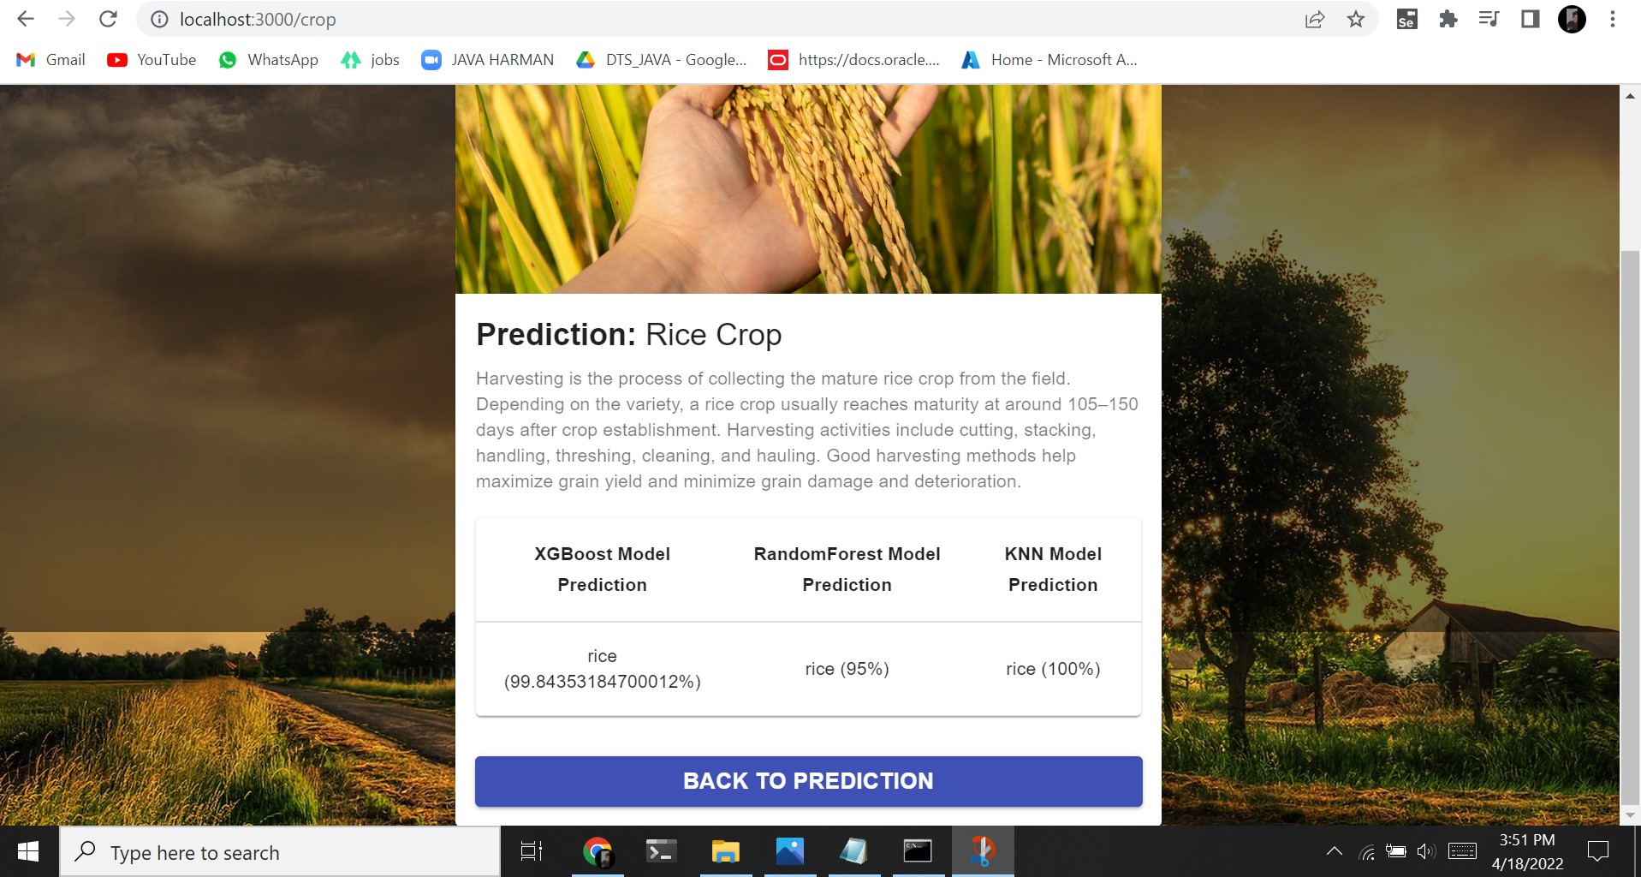

Slide 19
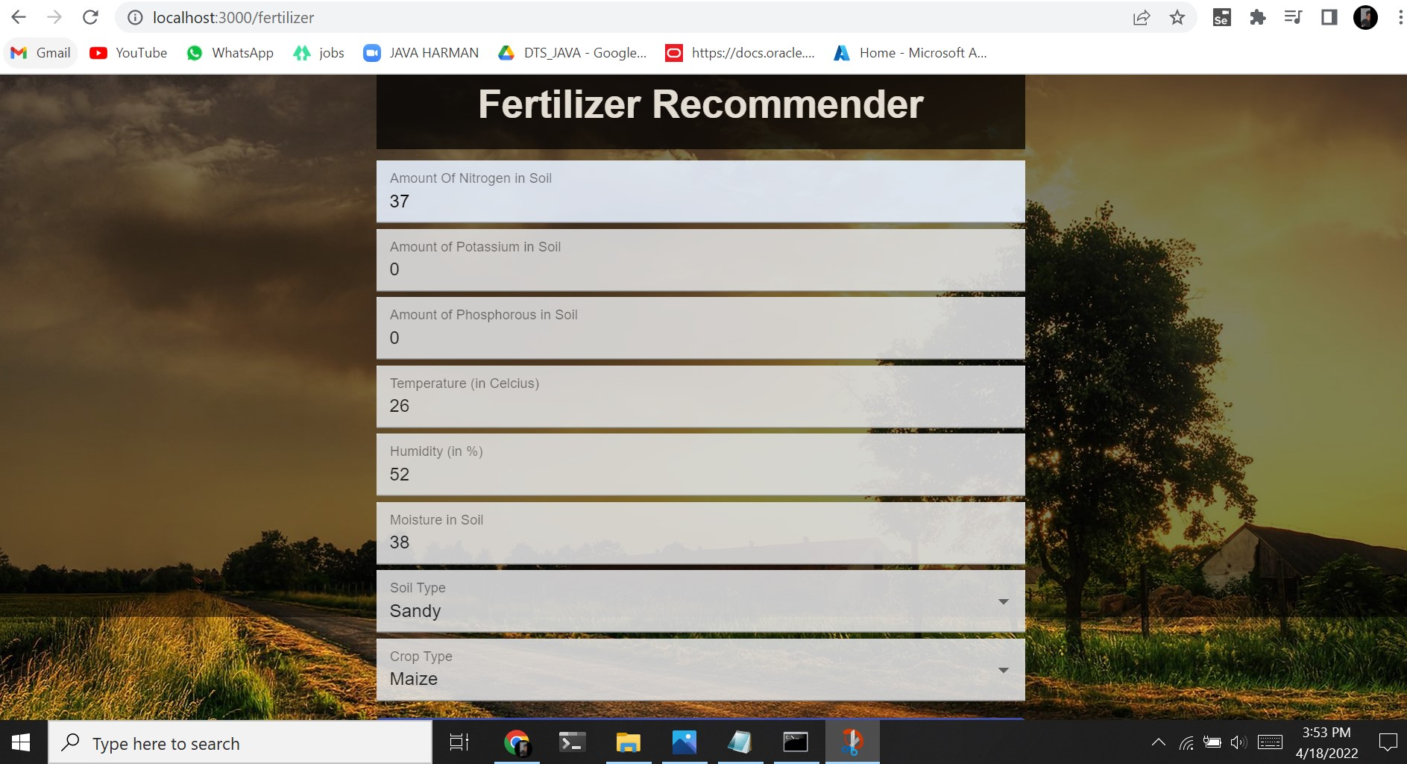

Slide 20
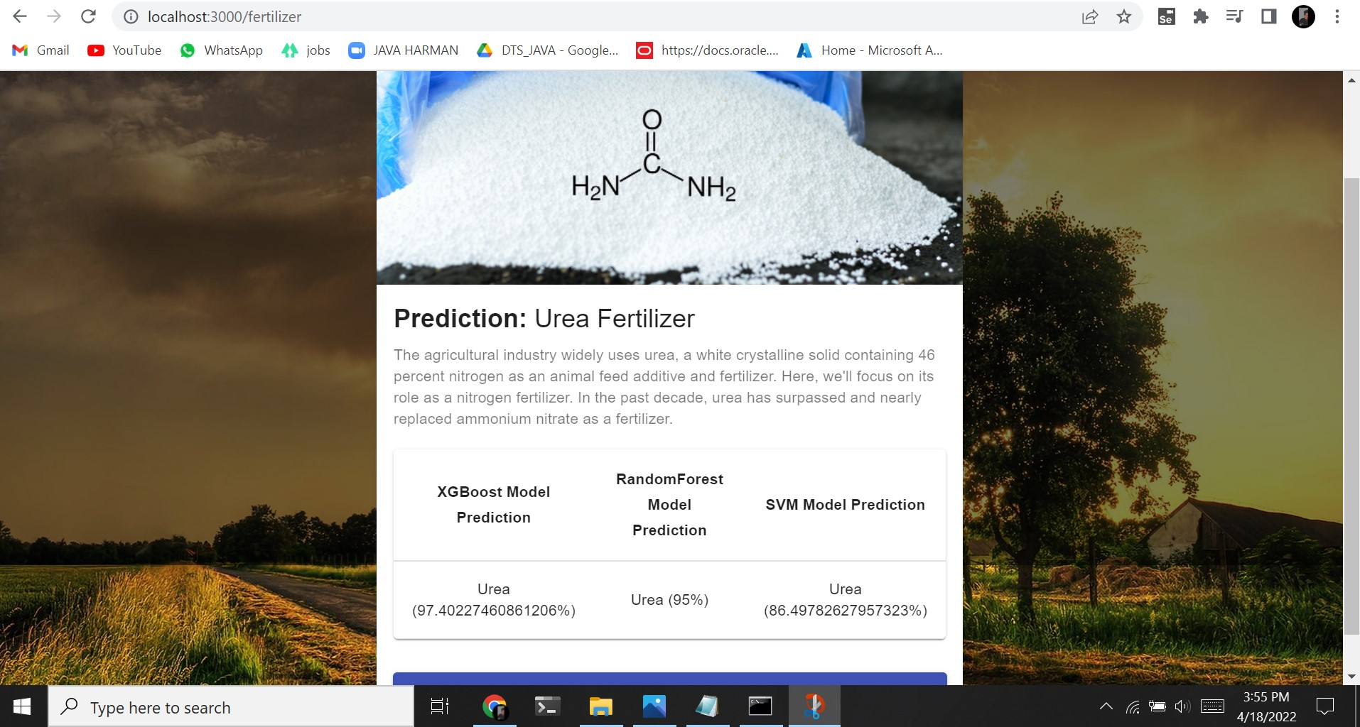

Slide 21
Conclusion and future scope
The prediction of crop yield based on location and proper implementation of algorithms have proved that the higher crop yield can be achieved.
From above work I conclude that for soil classification Random Forest is good with accuracy 86.35% compare to Support Vector Machine.
For crop yield prediction Support Vector Machine is good with accuracy 99.47% compare to Random Forest algorithm. The work can be extended further to add following functionality.
In fertilizer recommendation suitable crops and required fertilizer for each particular crop is recommended.

Slide 22
references
Rushika G., Juilee K, Pooja M, Sachee N, and PriyaR.L.(2018). Prediction of Crop Yield using MachineLearning, Issue 02 IRJET (pg 2337-2339).
Ruchita T, Shreya B, Prasanna D, and Anagha C(2017). Crop Yield Prediction using Big Data Analytics,Volume 6, Issue 11, IJCMS.
Niketa G, Leisa A.J., Owaiz Petkar, and AmiyaK.T.(2016). Rice Crop Yield Prediction in India usingSupport Vector Machines 978-1-5090-2033-1/16/$31.00 ©2016 IEEE.
S.Bhanumathi, M.Vineeth and N.Rohit (2019). CropYield Prediction and Efficient use of Fertilizers, (pg.0769-0773), ICCSP.

Slide 23
Thank you

